Slide 1
Quantification of Confocal Image using Python
Melis Çelik

Slide 2
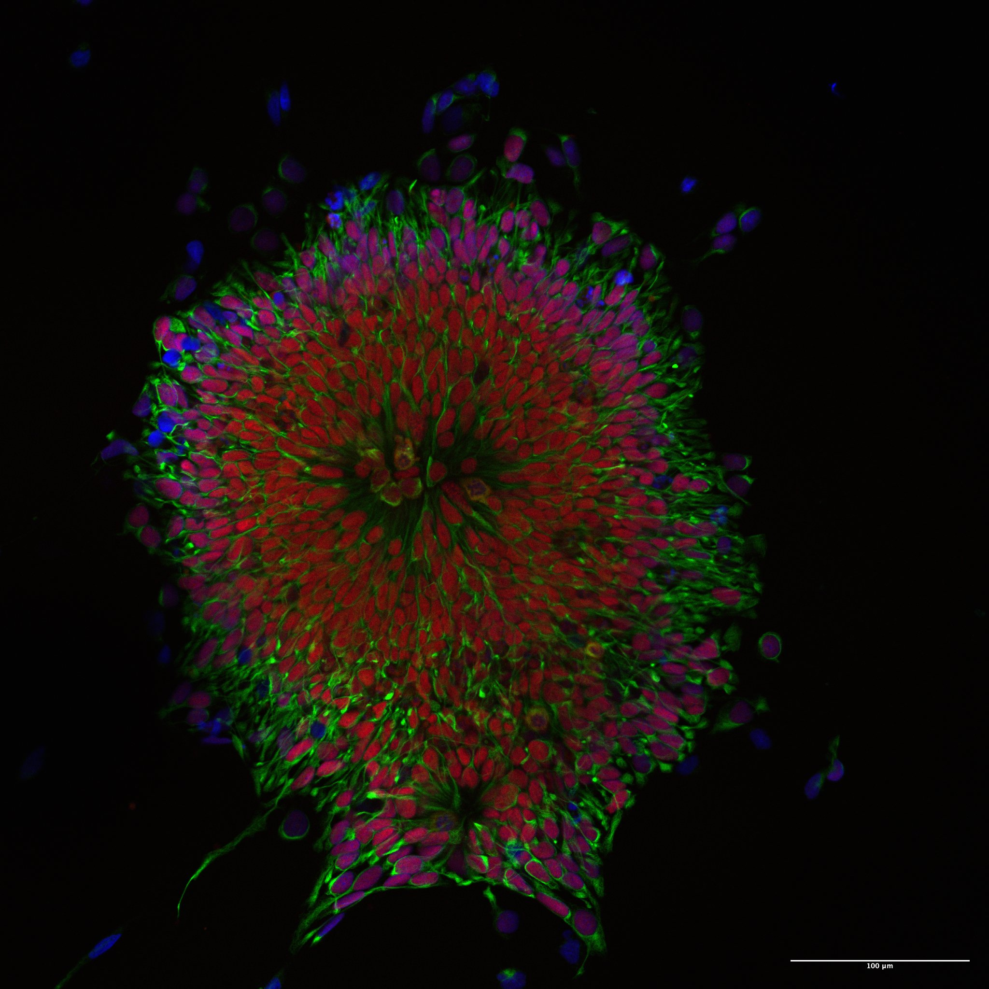
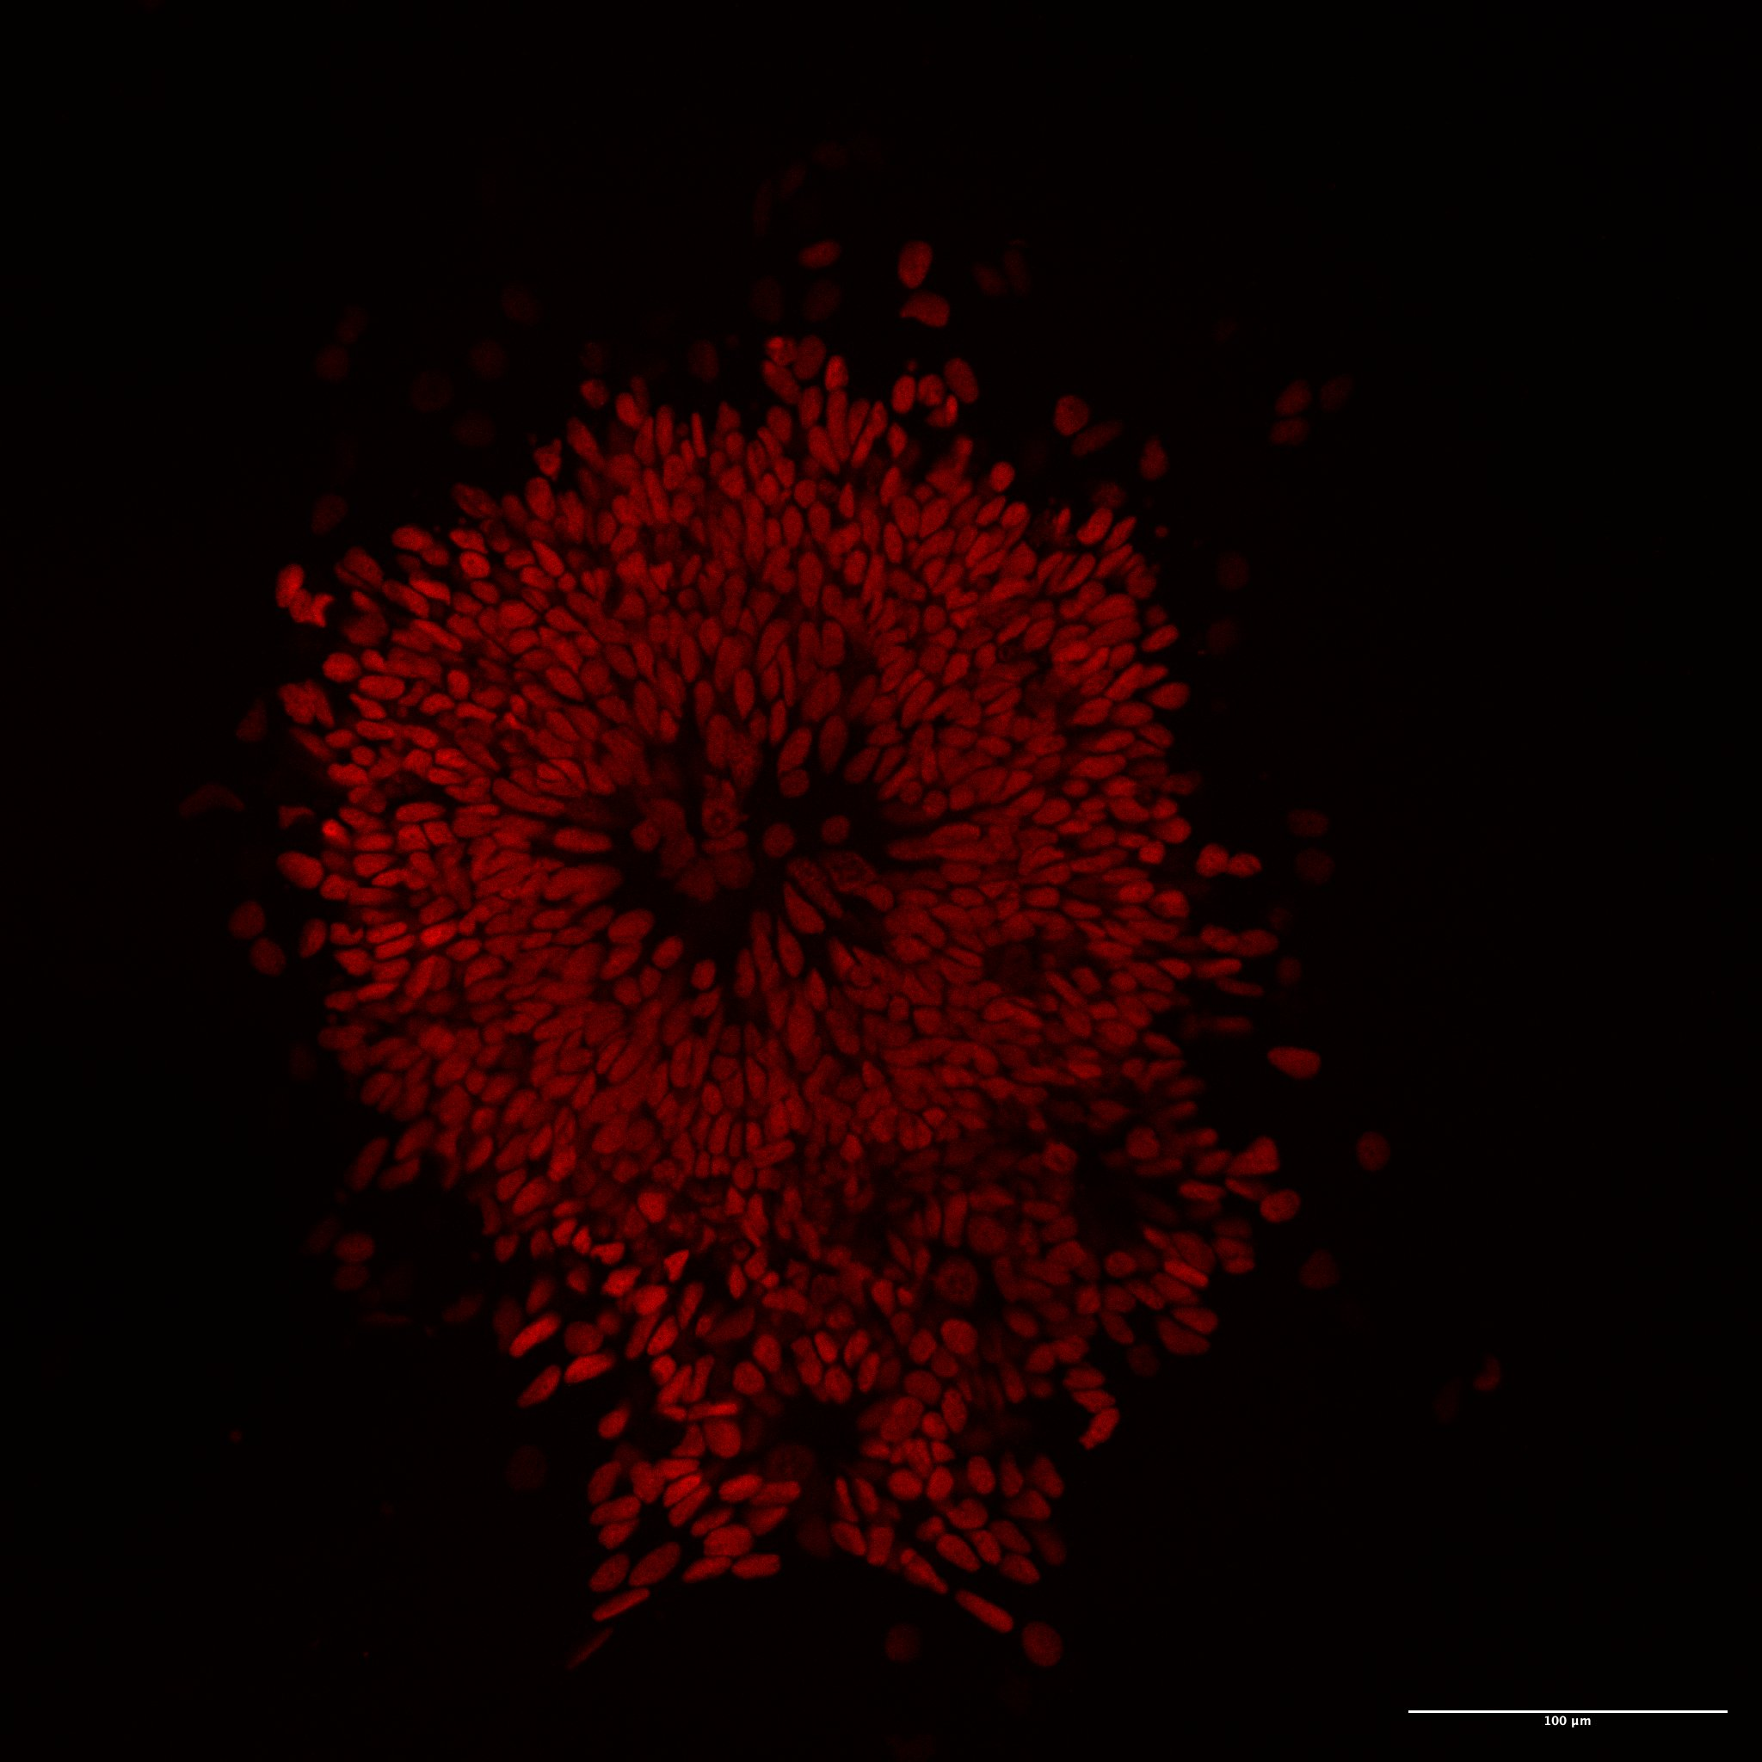
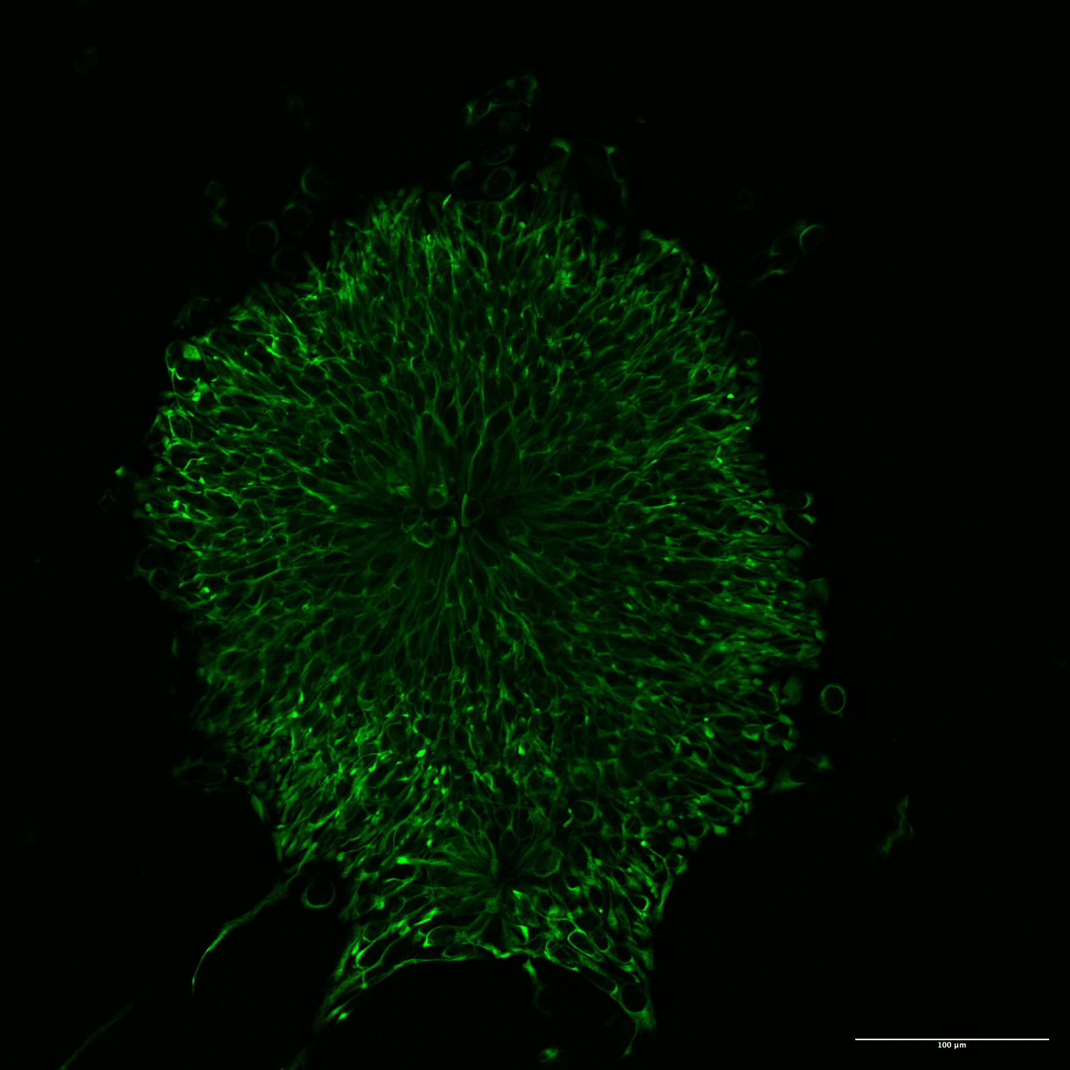
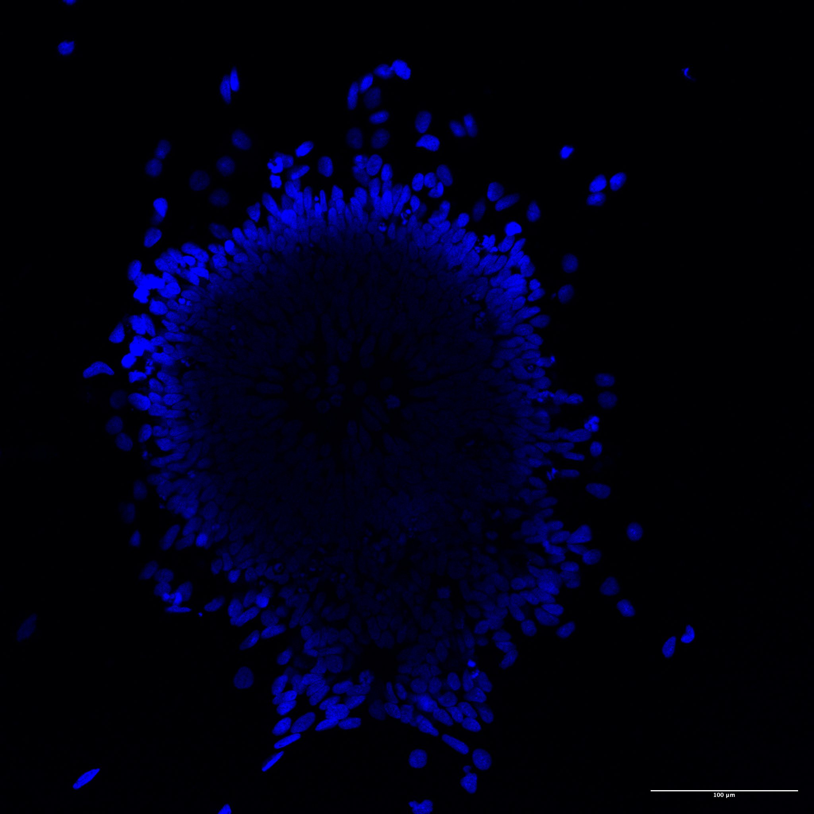
Background
Confocal microscopy is widely used for acquiring detailed images of biological samples.
We are using 3-channel confocal images (representing different wavelengths or fluorescent markers).

Slide 3
Aim
I would like to perform bioimage analysis with python for confocal data.
To quantify the signal intensity from each channels to analyze and compare them
To determining expression levels or understanding cellular processes.

Slide 4
Tools&Libraries
NumPy – for efficient array manipulation.
OpenCV (cv2) – for reading and manipulating images.
Seaborn – for plotting histograms or visualizing the images.
scikit-image – for advanced image processing techniques like segmentation.
Pandas – for organizing and analyzing results.

Slide 5
Overall Workflow
Step 1: Load and preprocess images by convert the image into grayscale or work with separate channels.
Step 2: Extraction of channels by splitting the confocal image into 3 channels (Red, Green, Blue)
Step 3: Quantification of signal by computing the pixel intensity or region-based methods to quantify signal from each channel which I do not know ☹
Step 4: Plot a visual plot to compare the signal intensities and number of positive cells for each channel to compare different images
Step 5: Statistical Analysis

Slide 6
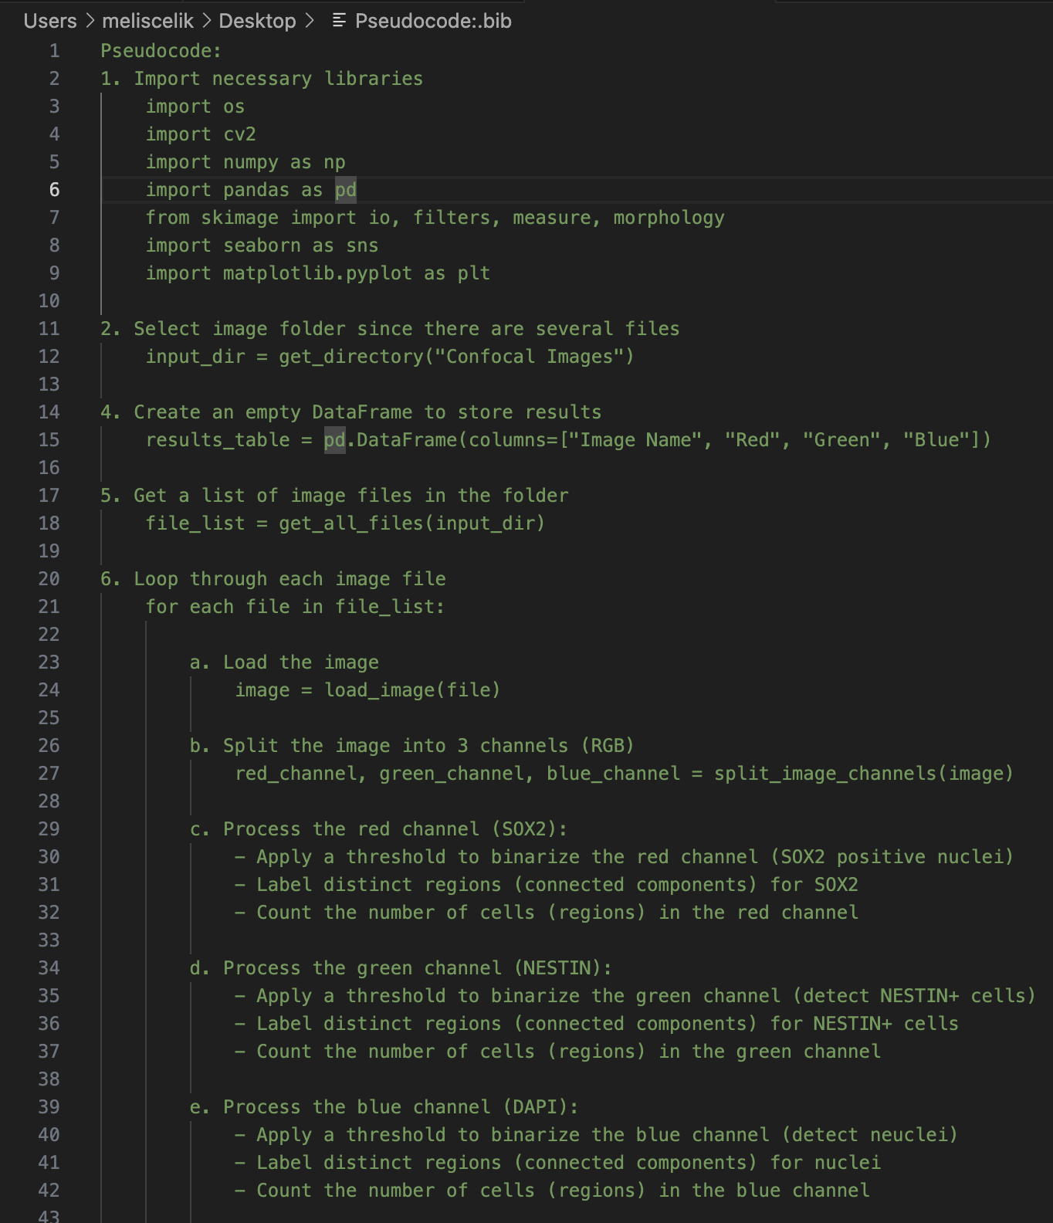
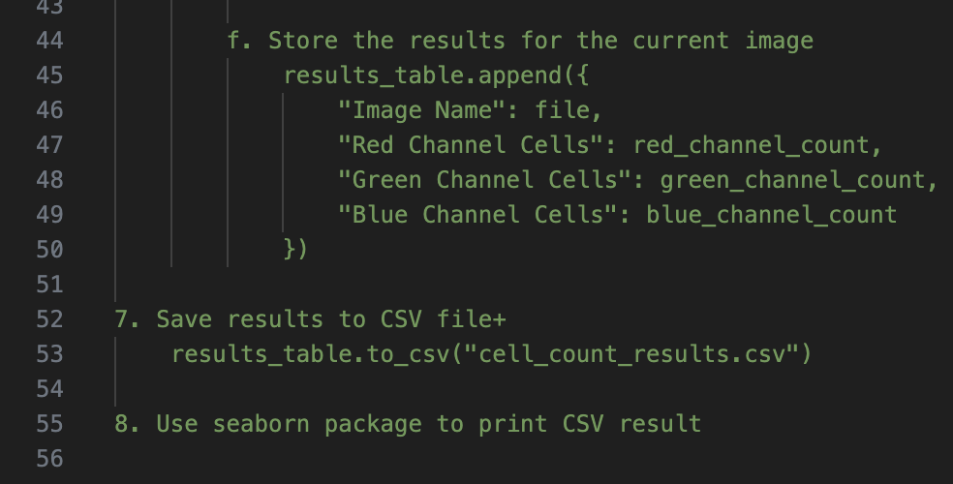
Pseudocode

Slide 7
Future Improvements
I would like to integrate the code that we run in Rafael’s lecture in mine like background normalization, preprocessing etc.

